Slide 1
Mathless Monads in C#: A Practical Approach
By Pieter Geerkens pgeerkens@hotmail.com copyright © 2016 Pieter Geerkens

Slide 2
Mon-ads as in monied; not Mo-nads as in gonads.

Slide 3
Introduction
What are monads? Introduce the monad pattern
A (very) little mathematics
Some monads (and almost-monads) we already know
Building a Maybe<T> monad: What? Why? How?
Traffic Light Demo – A moderately-complex Reader<E,V> monad
Benefits of monad implementation: LINQ syntax (fluent & comprehensive) widely available right up to Program.Main
Greatest Common Divisor Demo – step through several monads to a moderately complex use of State<S,V> monad
Observation on Code Contracts
Wrap-up

Slide 4
What are Monads?
Sometimes called a “Design Pattern” for types – too simplistic:
Various class and struct are declared, imposing additional structure on object and of which instances can be created
Various monad are declared (Maybe, State, IO, …) imposing additional structure on class and struct and of which instances can be created
Monads enable a higher level of abstraction by hiding:
Boilerplate details; and
Side effects
Monads of one flavour readily compose with each other
Monads of a different flavour require a Monad Transformer in order to directly compose with each other – next time
Too many Internet sources bog down in building each monad flavour – beg, borrow or steal a library already built.
Notes:
- Monad Transformers would provide an automated means of composing monad instances and flavours
- Implementing the same in C# requires manually writing each lift method
-

Slide 5
The Monad “Pattern”
Monads must have:
A base type: T
A constructor (sometimes called Unit or Return) that takes a single-argument of the base-type
A method (traditionally called Bind, but in LINQ called SelectMany) with signature (in C#): Monad<U> Bind<U> ( this Monad<T> @this, Func<T, Monad<U>> selector);
Bind captures the functionality of the monad in a manner that readily composes w/ other monads: (f bind g) ( x ) == f ( g ( x ) )

Slide 6
A Little Mathematics
A monad is just … … a monoid in the Category of endofunctors.
Translates to … a construct of the programming language that:
Maps other constructs of the programming language into similar constructs of the programming language
Composes with other similar constructs under an operation ○ (termed composition) where:
There exists some construct ί such that for all such constructs f:
ί ○ f == f ○ ί == f - Identity Law
And for all such constructs f, g, h:
( f ○ g ) ○ h == f ○ ( g ○ h ) - Associativity Law

Slide 7
Monads (almost) You Already Use
Nullable<T>: a T that could be null
Func<T>: a T that can be computed on demand
Lazy<T>: a T that can be computed on demand, then cached
Task<T>: a T that is being computed asynchronously but may not be ready yet
IEnumerable<T> and IQueryable<T>: ordered read-only sequences of zero or more T’s
Only IEnumerable<T> and IQueryable<T> (and their implementations) come with support for LINQ Comprehension Syntax out-of-the-box; the rest can be regarded as partially-implemented monads.

Slide 8
Additional Interesting Monads
Reader <in TEnvironment, out TValue>: Generates a succession of values from an initial environment supplied
State <TState, TValue>: Generates a succession of (State,Value) tuples from an initial state supplied
IO <out TValue>: Interacts with a hidden internal state (the real world) to generate and detect side-effect and return a succession of values reporting on those side effects.
Writer<TContent, TValue>: Outputs a succession of values to the specified content.

Slide 9
Maybe<T> Monad - Requirements
Capture method failure in the returned value
Short-circuit operations on earlier failure
Hide the boiler-plate code of testing returned value for failure
What about Nullable and Nullable<T> :
C# treats Nullable<T> as a struct!
C# doesn’t perform type-inference based on a :struct or :class constraint.
Difficult to directly leverage language constructs in a monadic fashion uniformly.
Combines to force boxing on any attempt to treat classes, non-nullable structs, and nullable-structs uniformly using only the native language features.

Slide 10
Maybe<T> Monad - Motivation
Uniform treatment of class, struct and Nullable
The concept that “no value exists” is valid even for non-nullable structs, such as a “divide by zero” attempt.
En passant – enable Language Integrated Query syntax by implementing SelectMany and Select extension methods

Slide 11
Maybe<T> Monad - Constraints
Implement as struct instead of class:
Reduce memory pressure on GC
Improve locality for better cache-line usage
More obviously immutable
Preserve base-type Equality: Reference or Value
Implement a HasValue property:
increases size of basetype (class and struct) but avoids boxing of struct
Accept struct, class, and Nullable as base-type
Use Code Contracts for static validation, to greatest extent possible :
Documents pre- and post-conditions of framework code
Statically disprove many null-reference possibilities

Slide 12
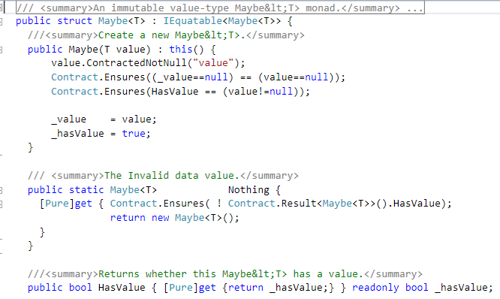
Maybe<T> Monad – Implementation 1

Slide 13
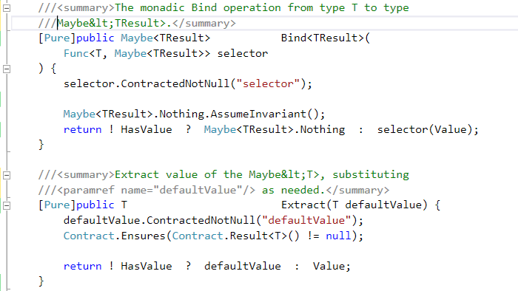
Maybe<T> Monad – Implementation 2

Slide 14
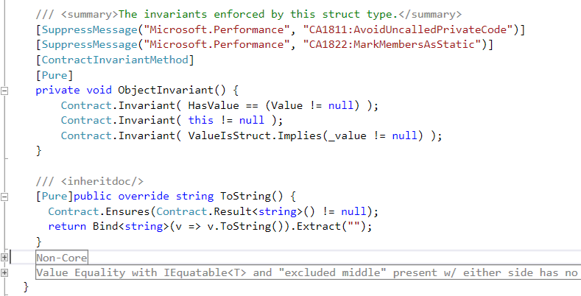
Maybe<T> Monad – Implementation 3

Slide 15
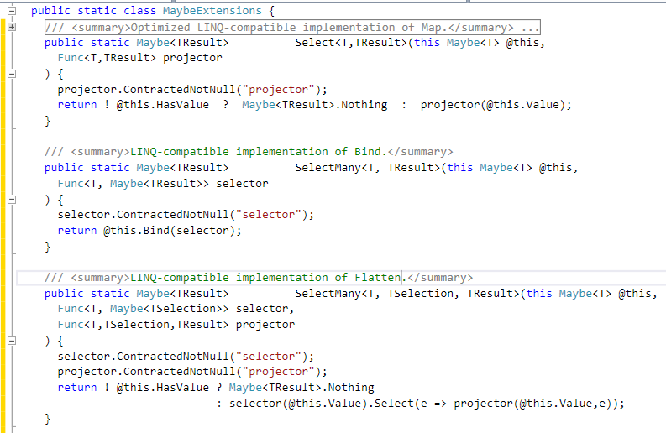
Maybe<T> Monad – LINQ Extensions

Slide 16
Maybe<T> - Recap
Very similar in external behaviour to Nullable<T>, except class acceptable as a base type as well as struct.
There is no Value property! Must use either Bind or Extract (or their LINQ aliases) instead. This is the key to statically-verifying the absence of null-references: No access to Value allowed (statically verified) until: behaviour on invalid Value provided by client
Extends the size of a struct by the smallest increment that the compiler/JITTER can store a Boolean in – better than boxing.
Effectively doubles the size of a class-reference (potentially) Can we do better?

Slide 17
MaybeX<T> - Classes-only
Just like Maybe<T> except:
Only class allowed as base-type – compiler doesn’t enable selecting both class and Nullable<T>
The property HasValue is calculated on demand, not stored
Wraps each class-reference as a struct; which it already was! That’s the essential difference between a C pointer and a C# reference
Doesn’t increase storage requirement until necessary for compatibility with Maybe<T>
Implicit cast operator to Maybe<T> makes this almost a sub-struct of Maybe<T> ; haven’t found how to usefully employ an IMaybe<T>.
Code available online but not reviewed in this presentation: only other significant differences are in the Code Contracts

Slide 18
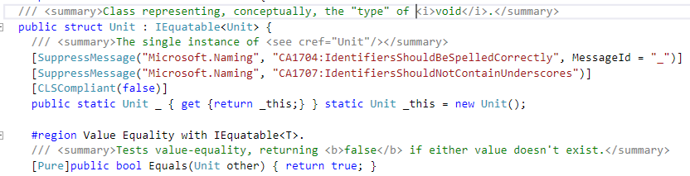
Unit is the type of void
Methods such as Console.WriteLine that return void will, in a monadic framework, return a monad on Unit instead; sometimes Unit itself, other times Func<Unit>.
Plus the rest of the standard implementation of value equality

Slide 19
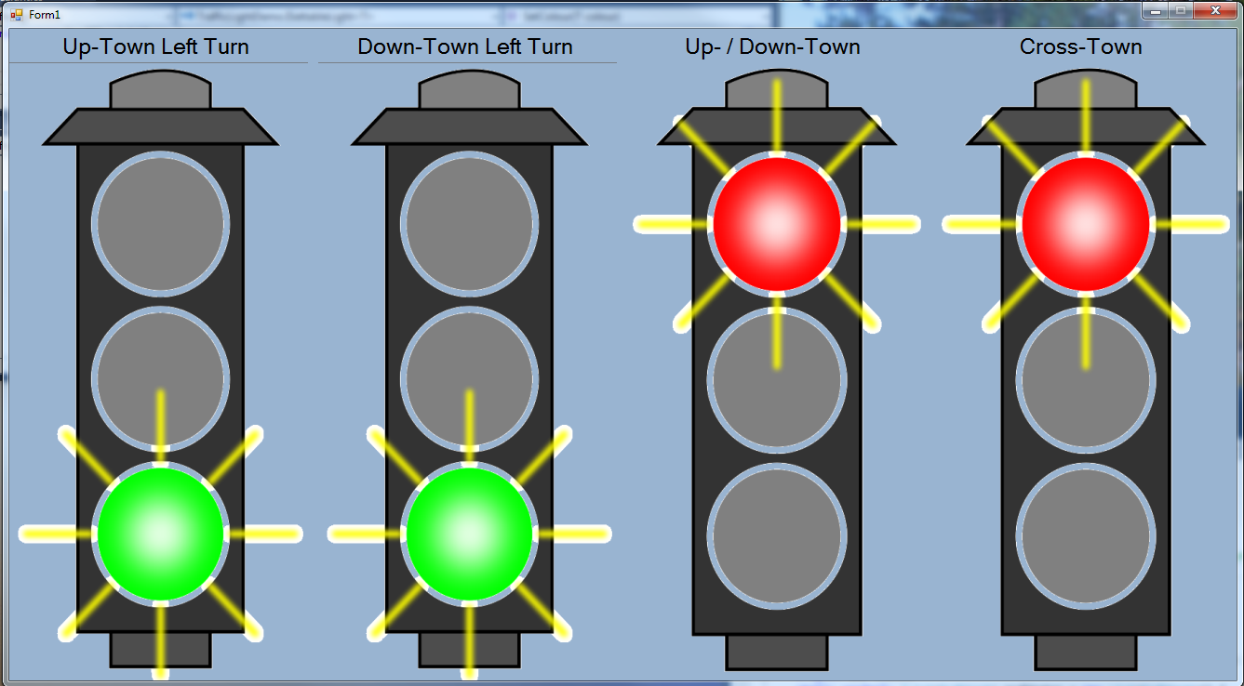
Traffic Light Demo - 1

Slide 20
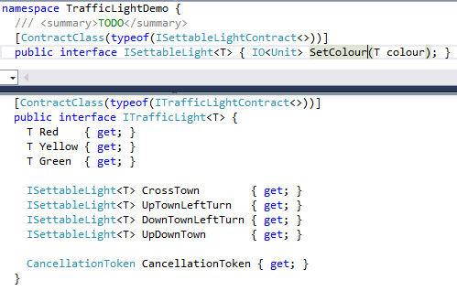
Traffic Light Demo - 2
Two generic interfaces define the state engine’s communication with the light display:
T is the type of whatever a light can be set to; Image for us

Slide 21
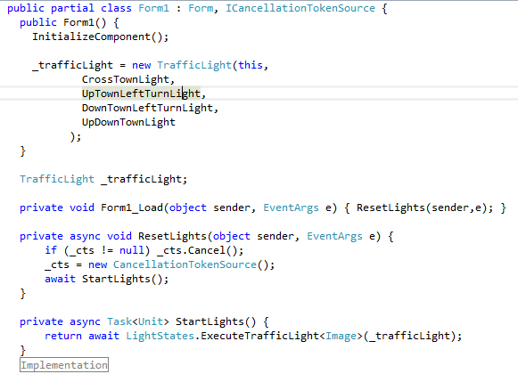
Traffic Light Demo - 3

Slide 22
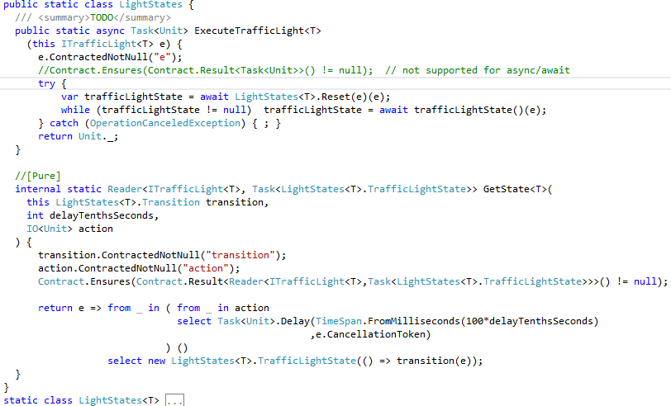
Traffic Light Demo - 4

Slide 23
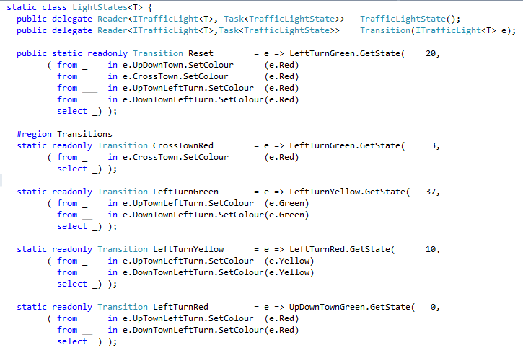
Traffic Light Demo - 5

Slide 24
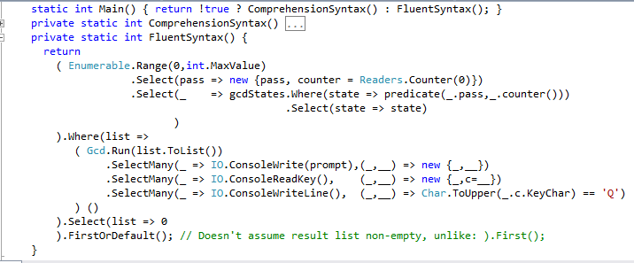
Wider Use of LINQ - Fluent Syntax
Not much gained with a single monad – but as additional programming constructs are implemented in this way, … … the capability of writing programs like this :
Notes:
If not well formatted easily becomes unreadable
Anonymous types must be explicitly managed

Slide 25
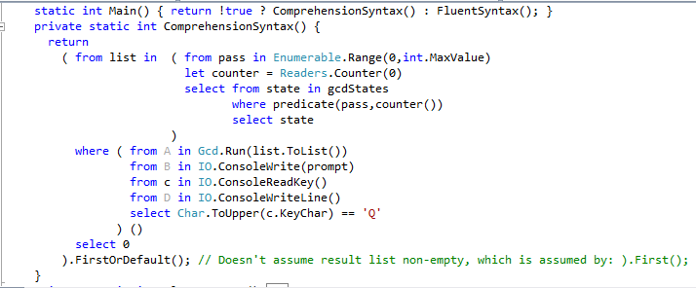
Wider Use of LINQ - Comprehensive Syntax
Not much gained with a single monad – but as additional programming constructs are implemented in this way, … … the capability of writing programs like this or this:
Notes:
The management of anonymous types is replaced by the (much simpler task of) managing unique range-variable names

Slide 26
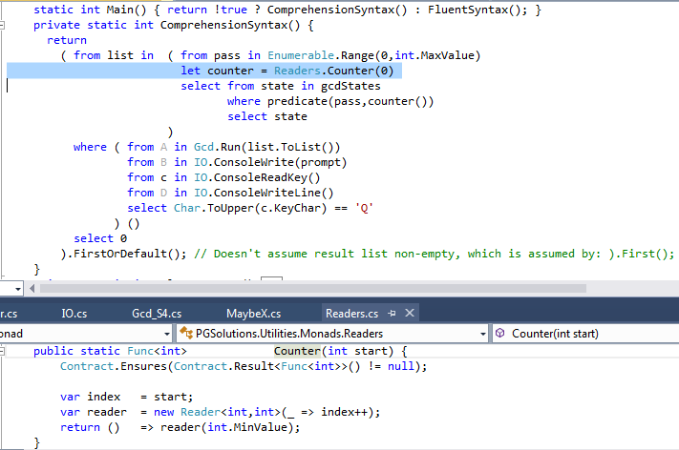
Greatest Common Divisor Demo - 1
Notes:
Functionality of Counter() relies on the automated creation of a closure by the compiler, on our behalf, over the variable index

Slide 27
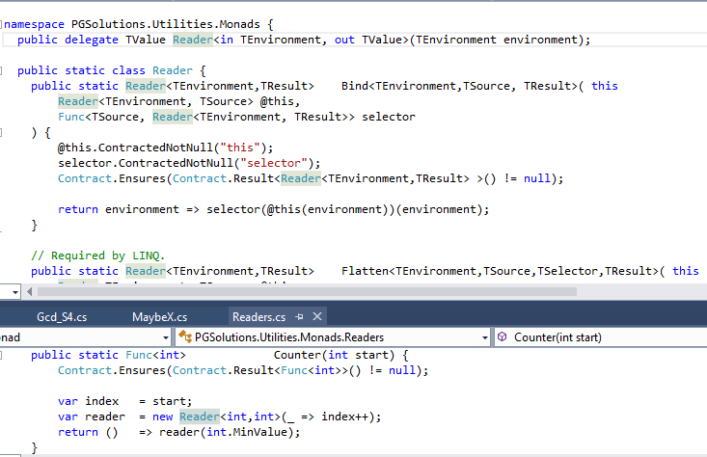
Greatest Common Divisor Demo - 2

Slide 28
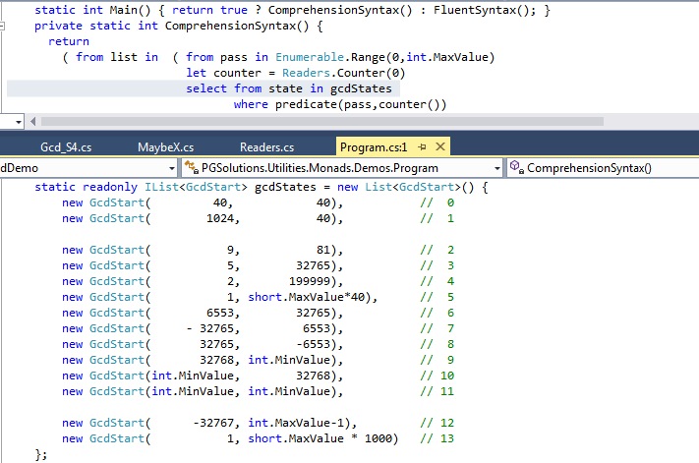
Greatest Common Divisor Demo - 3

Slide 29
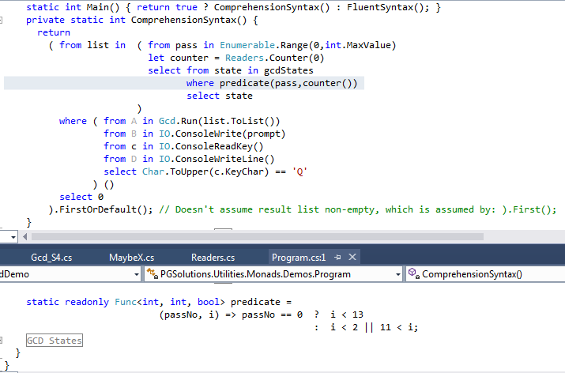
Greatest Common Divisor Demo - 4

Slide 30
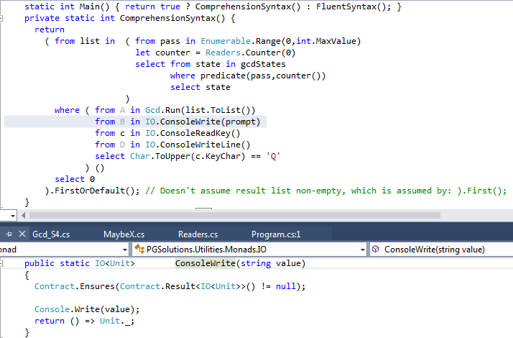
Greatest Common Divisor Demo - 5

Slide 31
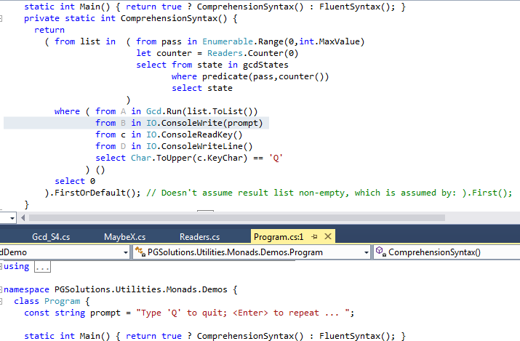
Greatest Common Divisor Demo - 6

Slide 32
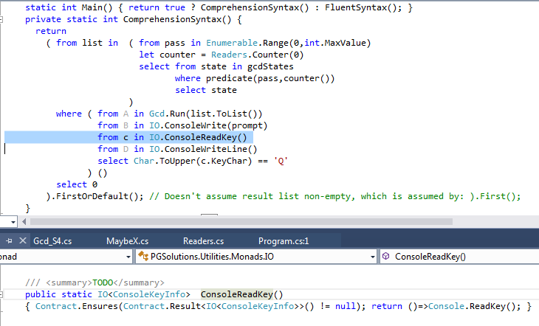
Greatest Common Divisor Demo - 7

Slide 33
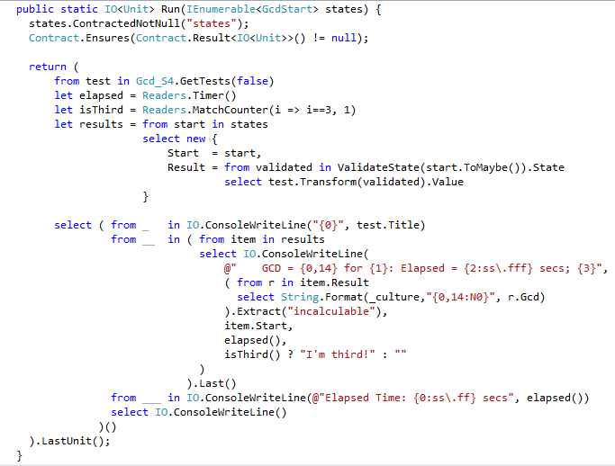
Greatest Common Divisor Demo - 8

Slide 34
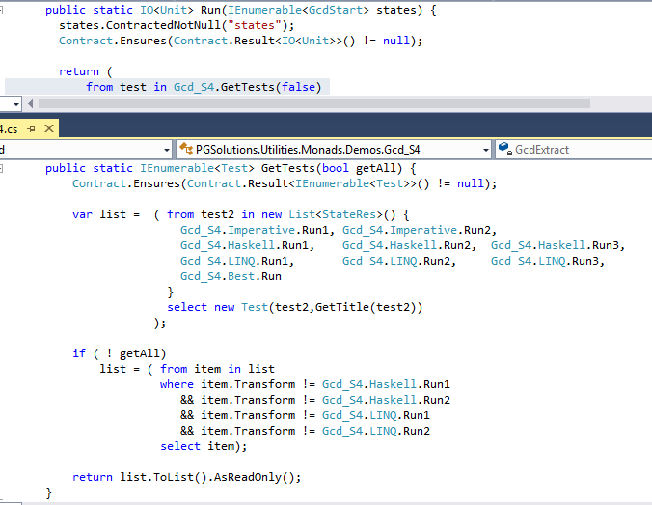
Greatest Common Divisor Demo - 9

Slide 35
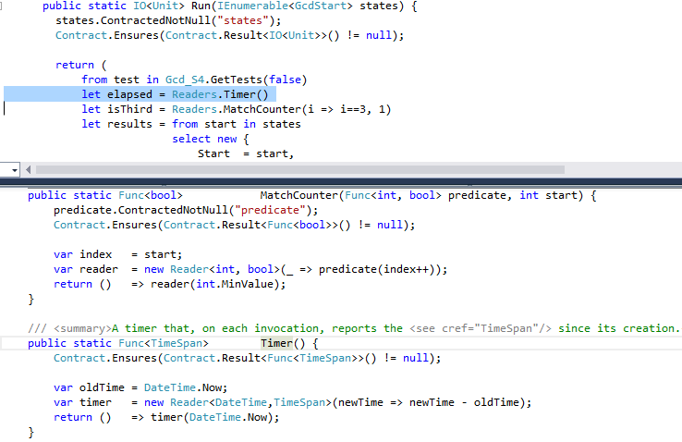
Greatest Common Divisor Demo - 10

Slide 36
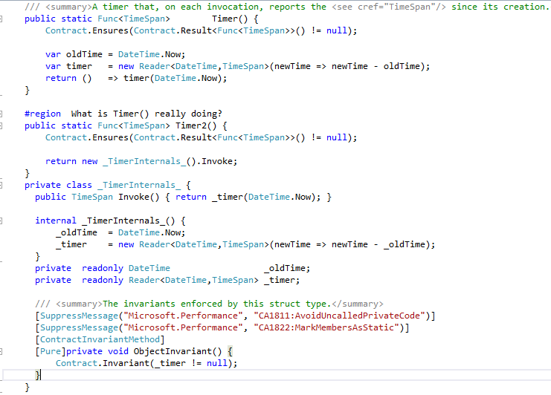
What is Timer Really Doing?

Slide 37
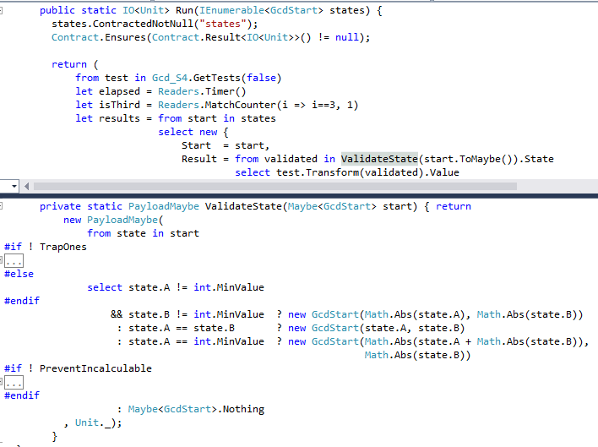
Greatest Common Divisor Demo - 11

Slide 38
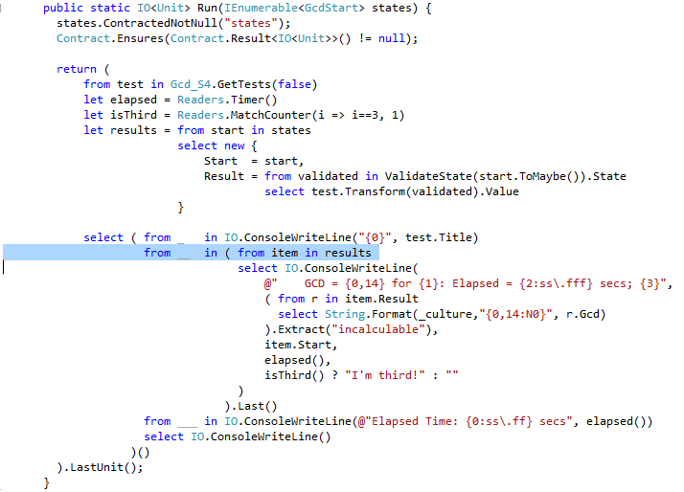
Greatest Common Divisor Demo - 12

Slide 39
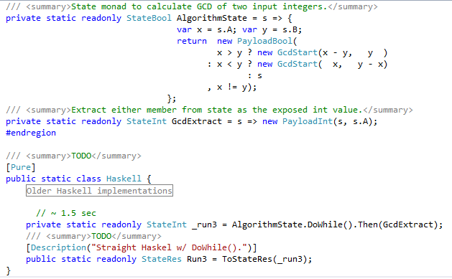
Greatest Common Divisor Demo - 13

Slide 40
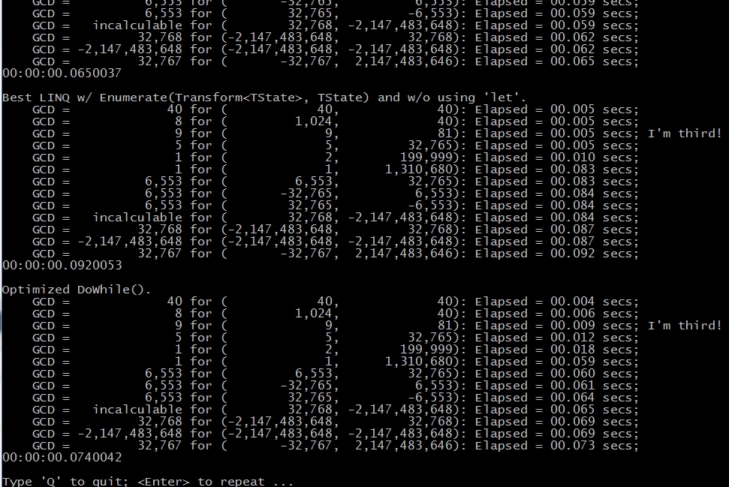
Greatest Common Divisor Demo - 14

Slide 41
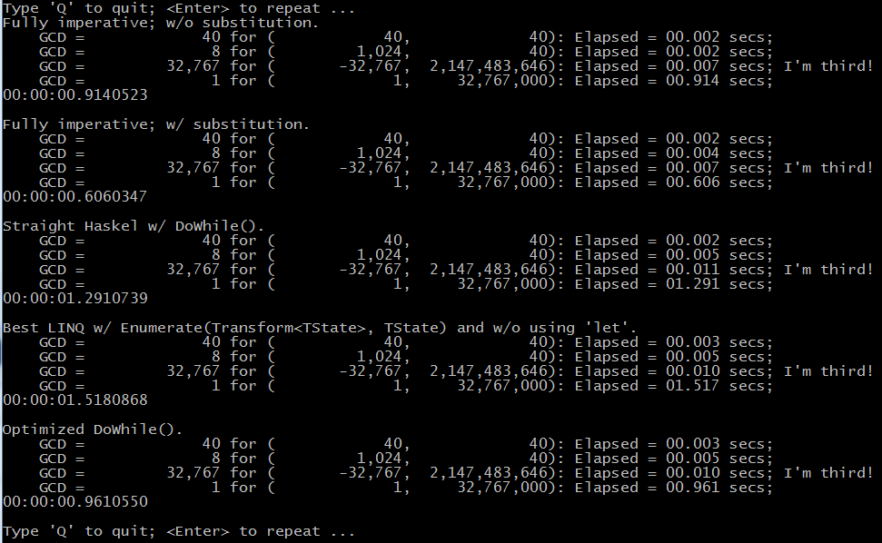
Greatest Common Divisor Demo - 15

Slide 42
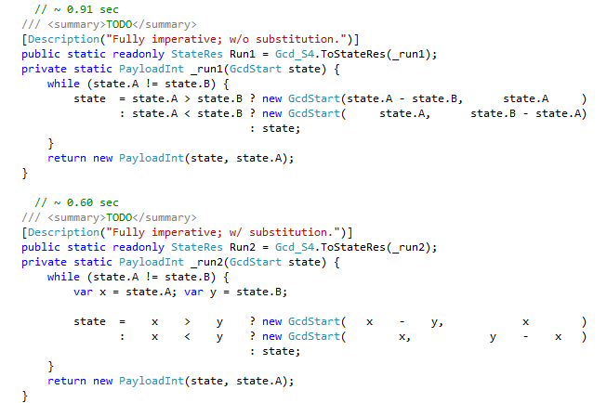
Performance Aside
Notes:
Nearly 35% performance improvement by explicitly saving the field values in local variables
Release build w/ all optimizations
A and B are get-only properties backed by private readonly fields

Slide 43
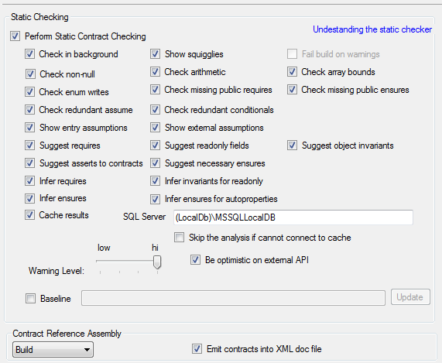
Code Contracts - 1
Full static checking w/ Code Contracts …

Slide 44
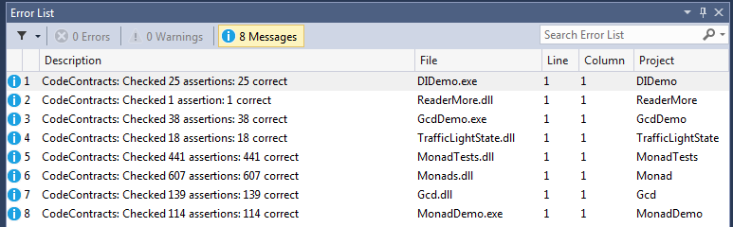
Code Contracts - 2
… provides static elimination of null-reference violations through a broad slice or silo of the code
Async and await remain a challenge – not (yet) supported by the Framework

Slide 45
Conclusions - 1
Distinction between monad flavours and monad instances
How monads instances compose with each other
Just enough math to understand monad construction
Some familiar monad flavours:
Nullable<T>
IEnumerable<T> and IQueryable<T>
Func<T>, Lazy<T>, and <Task<T>
The Maybe<T> and MaybeX<T> monads:
Requirements, motivation, constraints & implementation
Enabling LINQ w/ Select(), SelectMany() and SelectMany(,)
Reviewed use of Reader<E,V> and IO<T> in TrafficLight demo

Slide 46
Conclusions - 2
Compose different monad flavours w/ LINQ by nesting
Reviewed use of Maybe<T>, Reader<E,V>, IO<T> and <State<S,V> in GCDDemo
Reviewed how the "hard" contracts for static null-reference validation can be abstracted into each monad
En passant:
Increased implementation of the monadic pattern enables discontinuance of many mixed-mode LINQ constructs
Better readability of code with complex LINQ executions
Static null-reference validation with simpler (client-level) contracts

Slide 47

Questions?

Slide 48
Acknowledgements
Wes Dyer: Yet Another Language Geek http://blogs.msdn.com/b/wesdyer/archive/2008/01/11/the-marvels-of-monads.aspx
Dixin Yan: Dixin’s Blog https://weblogs.asp.net/dixin?page=2
Mike Hadlow: Code Rant http://mikehadlow.blogspot.ca/2011/01/monads-in-c1-introduction.html
Eric Lippert: Fabulous Adventures in Coding http://ericlippert.com/2013/02/21/monads-part-one/
Mark Seeman: Ploeh blog http://blog.ploeh.dk/2011/02/04/TheBCLalreadyhasaMaybemonad/
Jon Skeet: EDULINQ – The E-Book http://codeblog.jonskeet.uk/category/edulinq/

Slide 49
For copies of the complete code
Email me at pgeerkens@hotmail.com with Subject: Maybe<T>

Slide 50
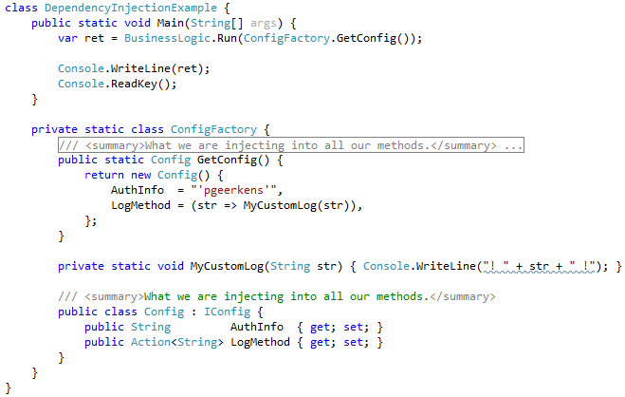
Dependency Injection Demo - 1

Slide 51
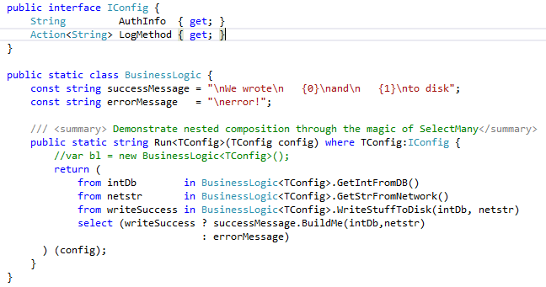
Dependency Injection Demo - 2

Slide 52
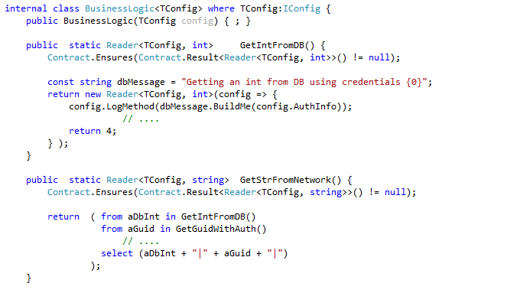
Dependency Injection Demo - 3

Slide 53
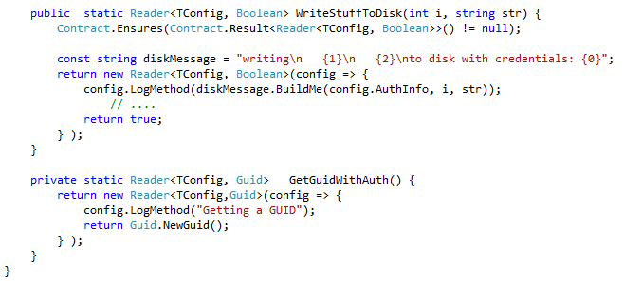
Dependency Injection Demo - 4

Slide 54
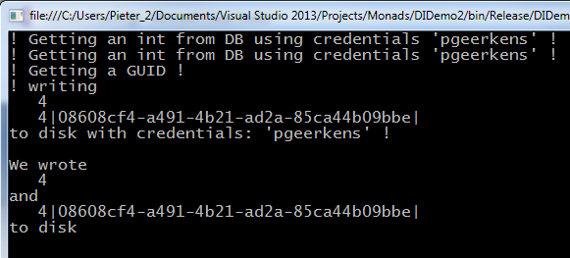
Dependency Injection Demo - 5

